Slide 1
Population genomics
Weicai
2017/1/9
B102

Slide 2
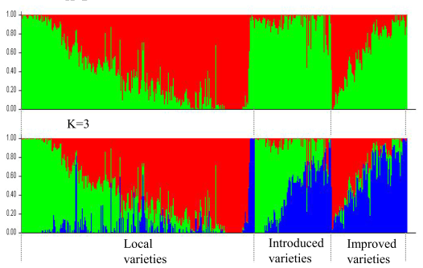
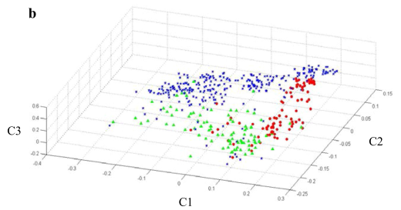
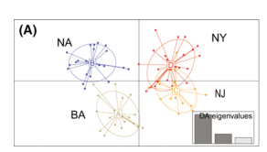
Populaton structure
Distance- based (Principal components)
Model-based clustering method

Slide 3
STRUCTURE
①The program structure implements a model-based clustering method for inferring population structure using genotype data consisting of unlinked markers.
②Population structure, assigning individuals to populations, identifying migrants and admixed individuals
K is characterized by a set of allele frequencies at each locus

Slide 4
microsatellites, SNPs and RFLPs
Within population
1. Hardy-Weinberg equilibrium
(p + q)² = p² + 2pq + q² = 1
A = p, a = q
AA, Aa, aa
2. linkage equilibrium
The random association of alleles at different loci

Slide 5
no admixture model
Admixture model
Ancestry Models
Linkage model
Model with informative priors
Correlated allele frequencies
Allele frequency models
Independent model

Slide 6
Ancestry model
1. No admixture model. Each individual comes purely from one of the K populations ands studying fully discrete populations
2. Admixture model. Individuals may have mixed ancestry, is a common feature of real data
3. Linkage model. This is essentially a generalization of the admixture model to deal with “admixture linkage disequilibrium”(genetic map)
4. Using prior population information. there is often additional informationthat might be relevant to the clustering

Slide 7
Allele frequency
1. Correlated allele frequencies:
Frequencies in the different populations are likely to be similar(migration or share ancestry)
2. Independent model:
Allele frequencies in different populations to be reasonably different from each other(improves clustering for closely related populations but over estimate k)
Same population = correlated model,

Slide 8
How long to run the program
Procedure induces correlations between the state of the Markov chain at different points during the run
(1) Burnin length: how long to run the simulation before collecting data to minimize the effect of the starting configuration
Summary statistics whether they appear to have converged(eg,α).Typically a burnin is 10000—100000

Slide 9
(2) How long to run the simulation after the burnin to get accurate parameter estimates.
Several runs at each K and whether you get consistent answers, 10000-1000000.

Slide 10
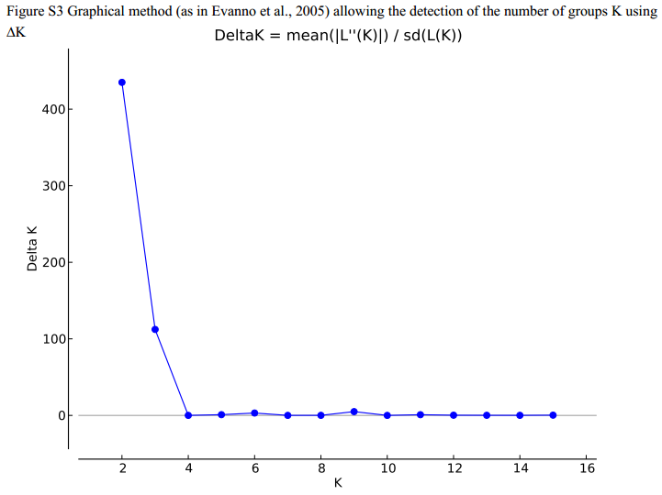
Results for structure

Slide 11
Principal Components Analysis
PCA is a statistical procedure that uses an orthogonal transformation to convert a set of observations of possibly correlated variables into a set of values of linearly uncorrelated variables called principal components(from wikipedia)

Slide 12
Statistics
covariance matrix, eigenvectors and eigenvalues, Feature vector(max)

Slide 13
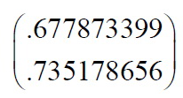
The covariance matrix of three variable

Slide 14
减少变量的个数
确保变量之间的相互独立性并保持大部分的信息。
提供一个框架来解释结果。
PCA ( prcomp, dudi.pca, ade4 R packages)
PCoA: Principal Coordinate Analysis (DARwin software) DAPC: uses k-means clustering and the Bayesian Information Criterion (BIC) to identify the optimal number of clusters in the data (dapc R packages)
Eignsoft (smartpca.c)

Slide 15
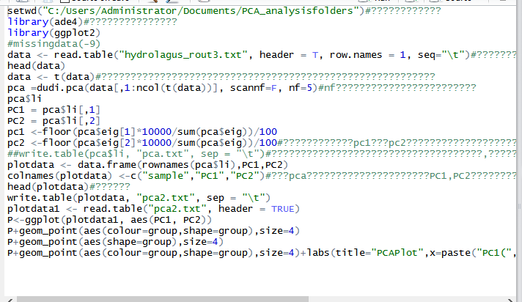
Dudi.pca fuction in R-package ade4 implemented in R-Studio
Install packages (ade4, ggplot2, grip )

Slide 16
DAPC: R- package in adegenet
It transforms the data using PCA, and then performs a Discriminant Analysis on the principal components (PC)
1. DAPC was used to identify and describe clusters of genetically related individuals.
2. The absence of any assumption about the underlying population genetics model, in particular concerning Hardy-Weinberg equilibrium or linkage equilibrium.

Slide 17
Input file:
- genind: a class for data of individuals ("genind" stands for genotypes-individuals).
- genpop: a class for data of groups of individuals ("genpop" stands for genotypes-populations)
- genlight: a class for genome-wide SNP data.
.pink
.snp
SNP can also be extracted from aligned DNA sequences with the fasta forma using fasta2genlight.

Slide 18
Transfrom PCA: genlight glPca from adegenet; dudi.pca fuction from ade4.
find.clusters: to identify clusters without prior using k-means. From stats package.
xvalDapc: The function xvalDapc performs stratified cross-validation of DAPC using varying numbers of PCs
dapc: Discriminant Analysis of Principal Components
scatter.dapc: Graphical methods for DAPC

Slide 19
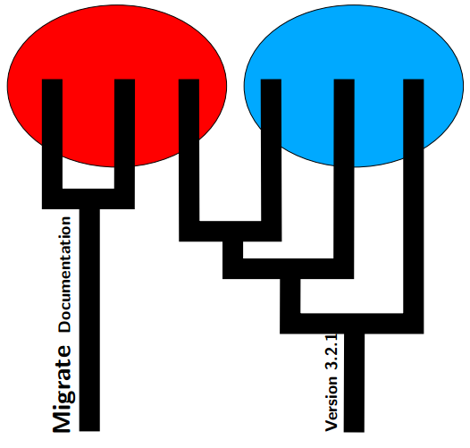
The program migrate estimates population size and migration parameters using genetic data.

Slide 20
1. The effective population size of a population 2. How well populations interact with other populations
•Behavioral or ecological approach: monitoring
•Genetic makeup: F_{st} (how isolated populations), allele frequencies(Wright-Fisher population model), coalescent

Slide 21
Recent approaches based on the coalescent (Kingman, 2000) allow better formulation of explicit probabilistic model that can handle different immigration rates and different population sizes, and also the addition of additional complications, such as recombination, population splitting etc.

Slide 22
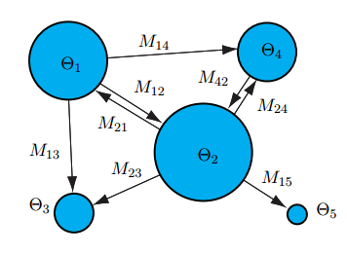
Theoretical consideration
Ɵ : mutation-scaled effective population size; ʍ : mutation-scaled effective immigration rate;
μ：mutation rate;
M: immigration rate
Ɵ = x*N_{e} *μ；
ʍ = m/μ;
Ɵ *ʍ = x*N_{e}*m: The number of immigrants per generation;

Slide 23
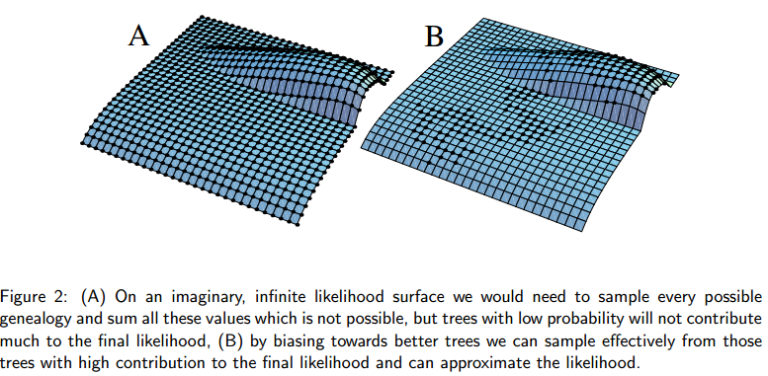
1. Maximum likelihood estimation of migration rates(mature)
2. Bayesian inference(favor)

Slide 24
Input file format
SNP: N, nucleotides; H, HapMap

Slide 25
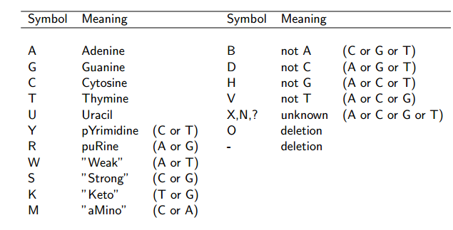
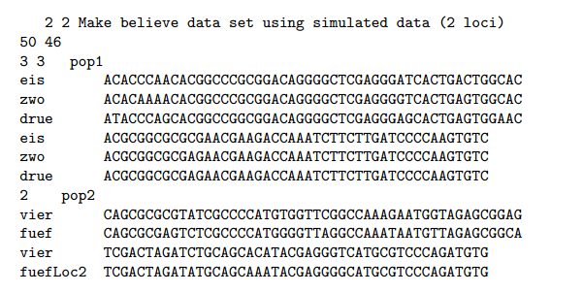

Slide 26
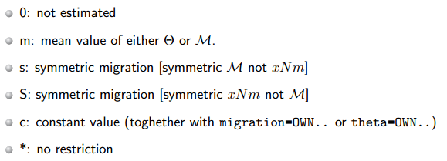
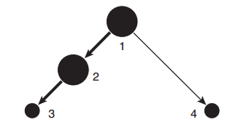
Migration model
1 2 3 4
1 * 0 0 0
2 * * 0 0
3 0 * * 0
4 * 0 0 *

Slide 27
Bayesian inference
generate posterior distributions
SLICE sampling
METROPOLIS sampling
Uses the current posterior distribution (taking into account the data) to generate a new state. For large data set, and fast with less MCMC chain.
MH-sampling picks a value from the prior and then uses the data later in the rejection-acceptance step to accept or reject the new value. solwer

Slide 28
Achieving good results with migrate
1. Change the random number seed and check if you get similar results.
2. Use the heating scheme if you get wildly different results and have low acceptance ratios.
3. Run with replicates=YES:10 and perhaps also using randomtree=YES, but beware this will run 10x longer then your single run.
4. If the results do not change much , perhaps you can stop. Otherwise increase the length of the chains, increasing the increment.

Slide 29
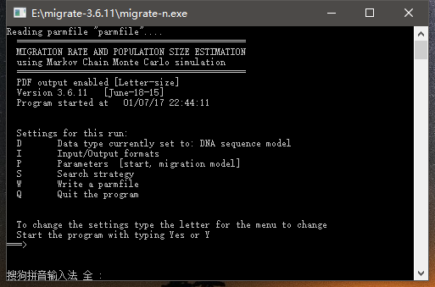

Slide 30
A example named twoswisstowns
Bayes factors are ratios of marginal likelihoods. In contrast to maximum likelihood, the marginal likelihood is the integral of the likelihood function over the complete parameter range. MIGRATE can calculate suchmarginal likelihoods for a particular migration model (Beerli and Palczewski 2010)
Decide on the models that are interesting for a comparison
Run each model through MIGRATE
Compare the marginal likelihood of the different runs and calculate the Bayes factor and calculate the probability for each model

Slide 31
Models:
Model1: full model
Model2: full model
Aadorf Bern
Aadorf * *
Bern * *
Aadorf Bern
Aadorf * 0
Bern * *
Model3: full model
Model4: full model
Aadorf Bern
Aadorf * *
Bern 0 *
A model where Aadorf and Bern are part of the same panmictic population

Slide 32
Results

Slide 33
•Approximate Bayesian Computation(ABC) is a bayesian approach in which the posterior distributions of the model parameters are determined by a measure of similarity between observed and simulated data.
•Statistics summarizing information: mean number of alleles per population or genetic distances between pairs of populations.
•Similarity through the Euclidian distance(Beaumont et al. (2002)): 1. normalization by standard deviations of simulated statistics; 2. weighted local linear regression.

Slide 34
ABC introduction
ABC approach has demonstrated its ability to stick to biological situations that are much more complex and hence realistic.
Model,
prior parameter
Posterior distributions
Select the best model for observed data set

Slide 35
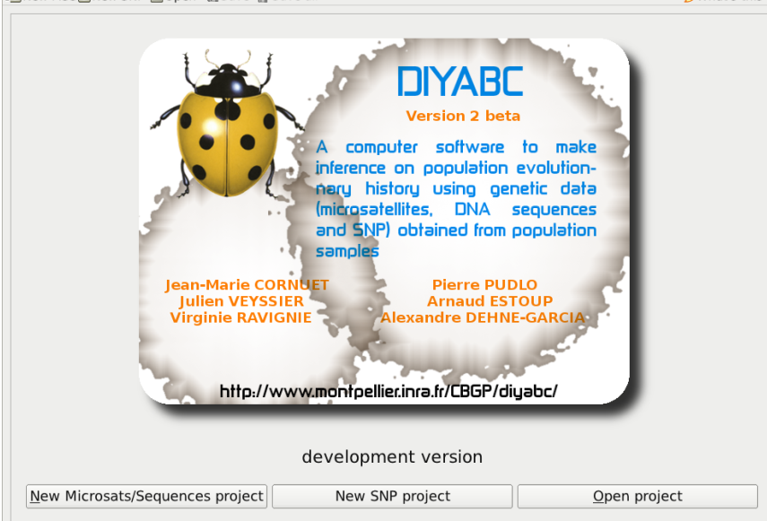
DiyABC: Inferring population history through Approximate Bayesian Computions

Slide 36
•DIYABC v0.x : wrote especially for microsatellite data
•DIYABC v1.x : designed to make use of DNA sequence data
independent and intra-locus recombination was not available, simple mutation(no insertion and deletion) but five categories of loci
•DIYABC v2.x : SNP marker
New analysis options to compute error / accuracy indicators conditionally to the observed dataset
Specify a MAF (minimum allele frequency) criterion
Simulation process of SNP datasets with much missing data

Slide 37
DiyABC steps
①: Generating simulated data sets;
②: selecting simulated data sets closest to observed data set
③: estimating posterior distributions of parameters through a local linear regression procedure
Comparsion models: 1. the relative proportion of each scenario in the simulated data sets closest to observed data sets. 2. logistic regression of each scenario probability on the deviations between simulated and observed summary statistics

Slide 38
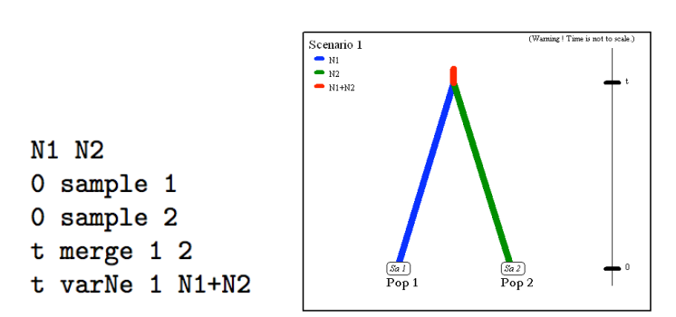
Historical model parameterization
4 events: divergence = merge, admixture = split, discrete change of effective population size = varNe, sampling = sample.

Slide 39
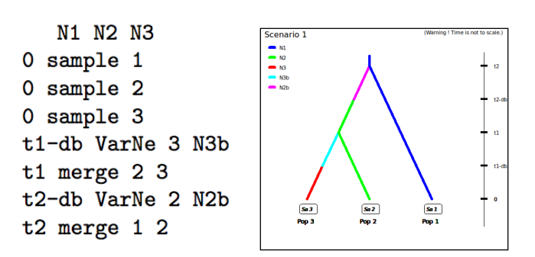
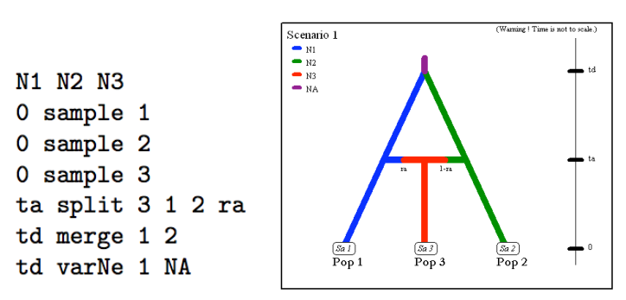

Slide 40
SNPs do not require mutation model parameterization
①Remove the loci with very low level of polymorphism from the dataset and hence increase the mean level of genetic variation of both the observed and simulated datasets.
Non polymorphic loci should be removed,
Monomorphic loci would not be analysed.
②Reduce the proportion of loci for which the observed variation may corresponds to sequencing errors(appling a default MAF (minimum allele frequency) criterion).

Slide 41
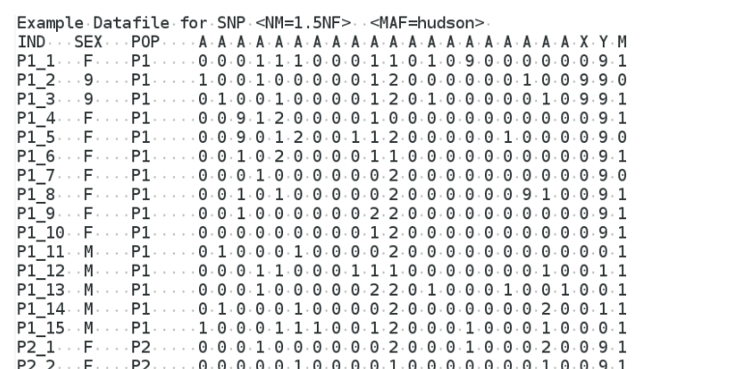
letter A for an autosomal locus, X for an X-inked locus, Y for a Y-linked locus and M for a mitochondrial locus.

Slide 42
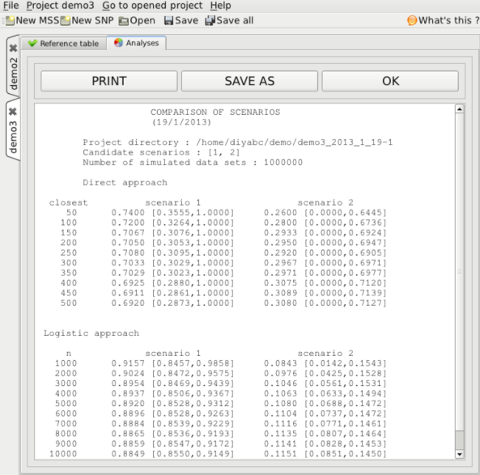

Slide 43
谢谢批评指正！

